Slide 1
TOPIC B2:
PROGRAMMING
LESSON B1-2
PROBLEM SPECIFICATION

Slide 2
AGENDA
Abstraction
Algorithmic Design
Decomposition
Pattern Recognition
Applications of Fundamental Concepts
NOTE!
Have a way to take notes and a way to write code available for this lesson

Slide 3

THE WARM UP QUESTION
What might be the goals of a program designed to solve the following problem?:
Freelancers often have trouble tracking how long they spend on projects

Slide 4
THE WARM UP ANSWER
Reduce time working over contract by 10%
Accurately bill exact hours worked for client
Organize multiple projects effectively
Track information in real time, rather than after the fact
Take 3 or fewer clicks to interact with each time

Slide 5

ABSTRACTION
ABSTRACTION

Slide 6
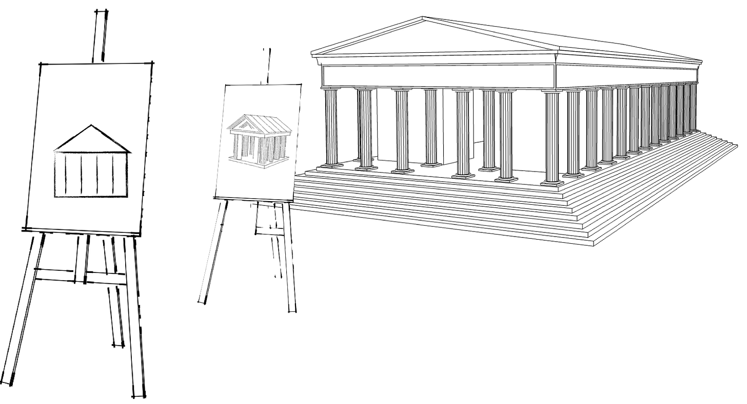
ABSTRACTION
Abstraction is the concept of extracting essential information while disregarding irrelevant data
This is used to propose or outline a feasible solution to a given problem
We design a simplified model that removes unnecessary details
Having a more simple model reduces unnecessary work

Slide 7
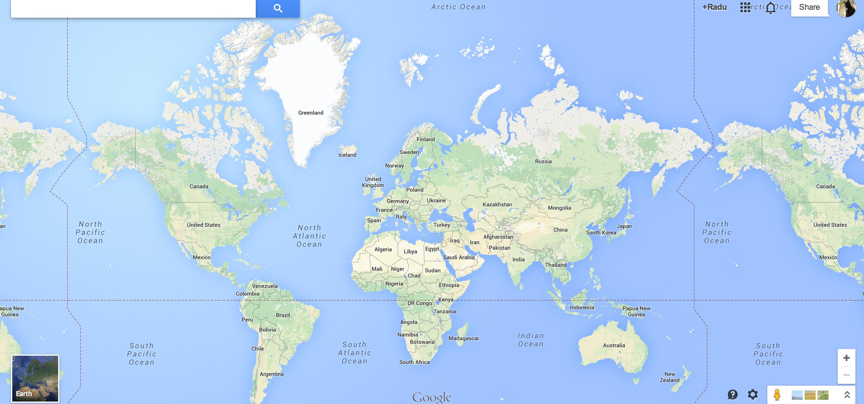
ABSTRACTION
Real world examples of this phenomenon include:
Designing a map to represent territory
A painting to represent a landscape
Timetables represent the distribution of time
Abstraction will come back in a big way during our OOP unit

Slide 8
ABSTRACTION
Using abstraction in the software development process helps to:
Reduce the time taken to create a piece of software
Make programs that are smaller in size and take up less space in memory
Customer satisfaction increases are requirements are met without unnecessary features

Slide 9
ALGORITHMIC DESIGN
Before sitting down to write the code, we should go through our problem specification process from the last lesson
Once you have a firm grasp on these requirements, we can design our potential solution

Slide 10

ALGORITHMIC DESIGN
Creating an algorithm is one of the most effective steps to plan a program
Algorithms are structured sequential instructions designed to address & resolve a problem
This is what I’ve been asking you to do since, pretty much, the start of our MYP class

Slide 11
ALGORITHMIC DESIGN
Given the following problem: A user is required to provide two whole numbers. Construct a program that calculates the sum of the two numbers and displays it.
We could write the following super labored algorithm:
1. Ask the user to enter a number
2. Store this number
3. Ask the user to enter another number
4. Store this new value
5. Add the two numbers together
6. Store the result
7. Display the result

Slide 12

ALGORITHMIC DESIGN
Doing this for your entire program obviously would take a lot of time, so I would recommend doing this for the most complex parts of your program as needed
Otherwise, write a more high-level algorithm for steps that aren’t too complex

Slide 13

DECOMPOSITION
Decomposition is the process of breaking down a complex problem into smaller, more manageable parts
You design solutions to the small problems, and then combine your smaller solutions together to make one large solution
If you work in a team, you can split the smaller chunks up among the teammates

Slide 14
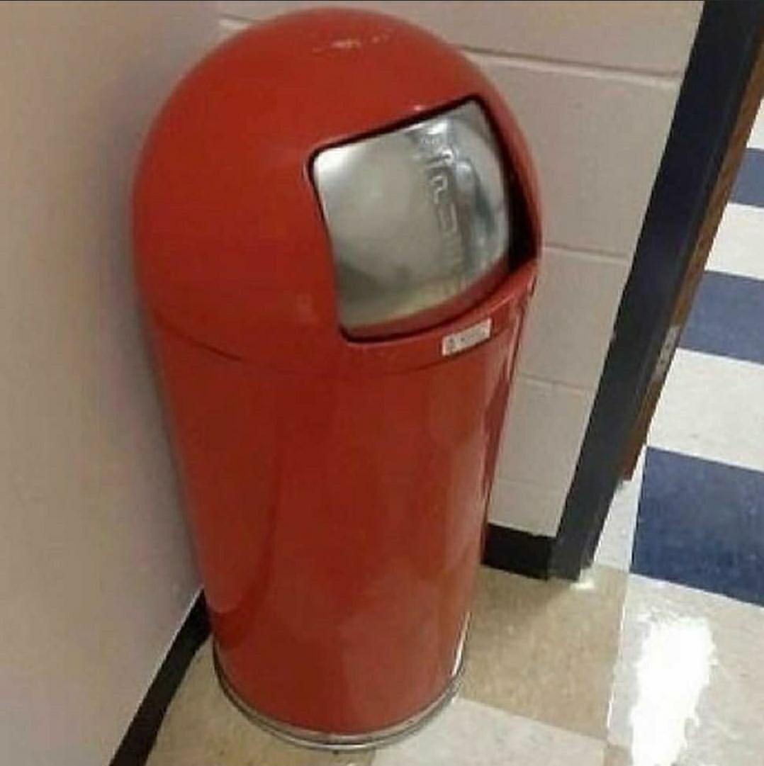
PATTERN RECOGNITION
Pattern recognition refers to identifying similarities in the details of problems
Focus on reusing solutions (lazy)
Part of modularity of our code
Functions tie into this

Slide 15
PATTERN RECOGNITION
Real quick, write a short code snippet that takes a list of numbers and prints out how many even numbers there are in the list

Slide 16
PATTERN RECOGNITION
Now, even quicker, write a program that prints out how many vowels are in a given string
For your if statement, use this:
if x in “aeiou”:
It’s an easy way to tell if a certain character or substring is contained within a given string

Slide 17
PATTERN RECOGNITION
What do you notice about these algorithms?

Slide 18
SOLVING PROBLEMS
All of these concepts are applied in pretty much every field in computer science
Let’s quickly look at a few and how these concepts apply to each

Slide 19

SOLVING PROBLEMS
Software development, of course, requires you to:
Understand the problem
Abstract unnecessary details
Find repeating patterns (like we just did)
Design efficient algorithms
Programming
Python’s built in functions such as len( ) are modular and abstracted
You don’t really know how they work, do you?

Slide 20
SOLVING PROBLEMS
Data analysis
Repetitive tasks are automated using algorithms
Market predictions are often made using algorithms
Machine learning
Just a big game of pattern recognition
Predict purchases based on buying habits
Find patterns of successful athletes
Abstraction excludes irrelevant data

Slide 21
SOLVING PROBLEMS
Database design:
Identify relevant data sources using abstraction
Design rational databases by using decomposition to break it into smaller problems
Pattern recognition to ensure databases are normalized
Network security
Abstraction enables generalization of complex security models
Pattern recognition to identify threats to the network
Decomposition breaks security into models

Slide 22
WORK IT (SHEET)
You can find WS B1-2 on Github! Have fun!

Slide 23
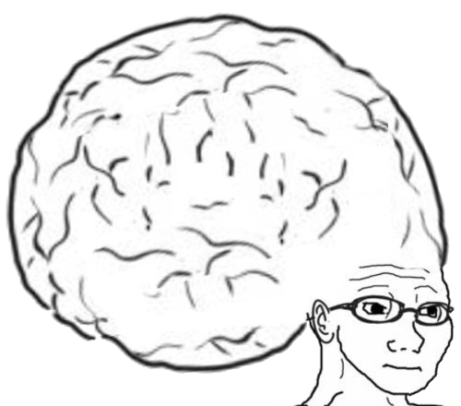
VOCAB TO REMEMBER
Abstraction
Algorithmic Design
Decomposition
Pattern Recognition

